Slide 1
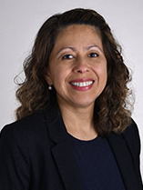
Bioengineering Colloquium
Gaby Medina-Meza, PhD
Associate Professor
Endocrinology, Diabetes and Clinical Pharmacology
Kansas University Medical Center
Beyond the Label: Engineering Innovations to Reshape Ultra-Processed Food Systems

